Slide 1



WTM Berlin
Android Study Jam
3rd Season!
1st of March

Slide 2
Agenda
Intro (~20 min.)
Review of lesson: Building Layouts: Part 1 (~30 min)
Break
Work with coaches and networking (aka don’t be shy)

Slide 3
Berlin Code of Conduct
http://berlincodeofconduct.org/
Notes:
We strictly follow the Berlin Code Of Conduct and we don’t tolerate any kind of bad behaviour as defined by the code of conduct.

Slide 4


Who Are We?
Women Techmakers Berlin
GDG Berlin Android
Babbel
Awesome People
Notes:
Lot’s of nice people make the study jam possible.
Women Techmakes, group of which I help, organizes tech meetups focused on inclusion of underrepresented communities in tech
GDG Berlin Android are your friendly local Android group
Babbel, our sponsor, also contributes by bringing their developers as coaches
And of course all our coaches (please say hi). Every coach do little introduction.

Slide 5
How to take part of the Android Study Jam
At Home
Follow the free Udacity courses:
Android Basics: User Interface
Android Basics: User Interaction
Do the lessons before the meetups
Do the practice sets
Build your first app
About 3 hours/week are required
If you encounter problems, no worries, we will help you at the meetups!
(You don’t need to stay until 10pm!)
At the meetups
Review the lessons with the group
Get help from the coaches
Meet other students
At the graduation
Present your app to the group
Vote for the best apps! (and maybe prizes)
Get a Certification of completion by Google

Slide 6

Calendar Android Study Jam
01.03.2017: Study Jam Kick-off + Building L. 1
15.03.2017: Building Layouts Part 2
05.04.2017: Making App Interactive Part 1
19.04.2017: Making App Interactive Part 2
03.05.2017: Object Oriented Programming Part 1
17.05.2017: Object Oriented Programming Part 2
07.06.2017: Project preparations
21.06.2017: Graduation!

Slide 7
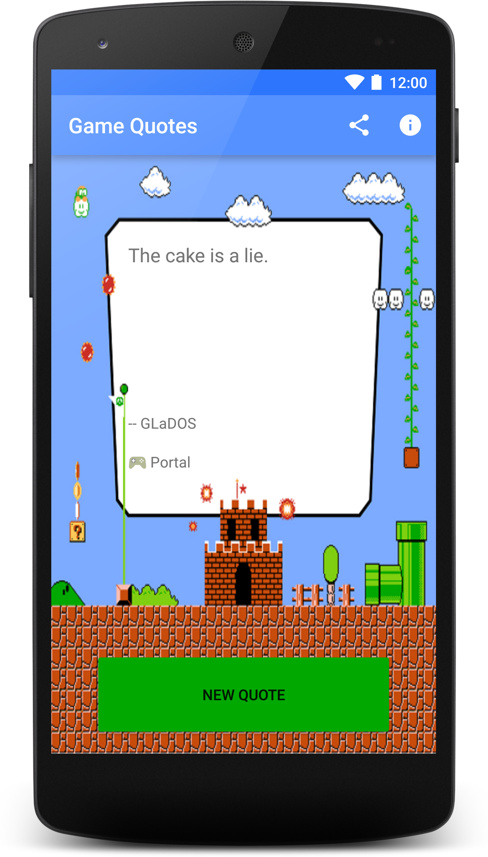
Your final Project
Single Screen App.
With things you learned at the course:
Layouts, ImageView, TextView, Buttons…
Open a browser, a location in Google Maps, a share intent...
Out Of Scope:
No storing things in phone
No network usage
Need ideas? Here’s some!
List of cool places to visit.
Quiz game.
Teach things to the user.
… or ask us!
Presentation: 21.06.2017

Slide 8
Sorry... I am lost!
Don’t panic! You have plenty of time to catch up!
Keep following the online course
Ask us anything: in person, in private, on Slack, via email, etc.
We want you to finish the course!
We will help you reach that goal!

Slide 9
FAQ
Do I need to attend to all the sessions?
No, we won’t keep track
Do I need to present an app as final project for graduation?
Yes, it is required for the certification
I skipped some lessons and I am lost. Can I still come to the events?
Yes! we will help you get back on track
Do I need to prepare the sessions at home?
Yes, self studying is part of the study jam
Do I need to install Android Studio?
You will do it during Practice Set 1
Do I need an Android device?
Not mandatory but nice to have

Slide 10

WTM Berlin - International Women's Day
Wednesday, March 8, 2017
5:00 PM to 10:30 PM
c-base Raumstation (Rungestrasse 20)
Talks on iOS development, product management and more
hiring companies for all level
lounge on the Spree
vinyl cutter machine
lightning talks about women in STEM

Slide 11
How to become an Android developer?
Long path (may take years)
Self-Learning
Conferences
Personal Projects
Study Jam
Meetups
Internship
Android Basics Nanodegree
Android Developer Nanodegree
Associate Android Developer Certification
Notes:
So to reach that goal, how do you become an Android developer? there’s no unique formula and it depends on each person
here’s a general idea of everything that you can do to reach that goal
Study Jam is a start, but won’t be enough for that
Udacity offers many programs, like the Nanodegrees and the Certification, to become one quicker
Self-Learning is the most important, I wanted to make the text bigger :D

Slide 12

Getting on Slack
http://adg-berlin.herokuapp.com/
Join channel #wtm-study-jam
You are very welcome to join other channels as well!
Anyone needs help getting on Slack?

